Slide 1
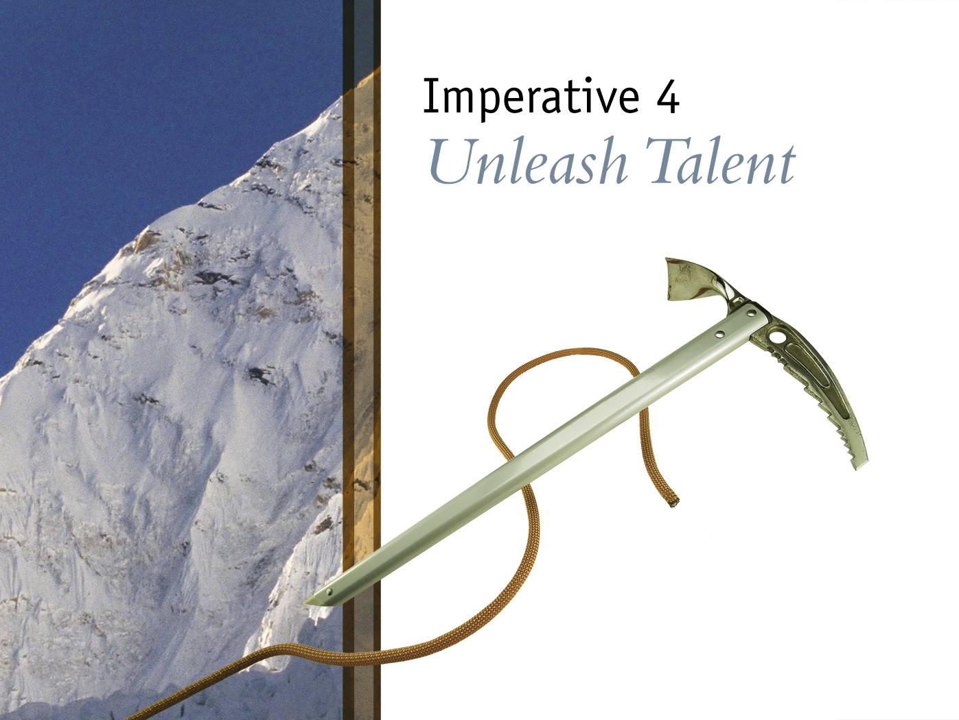

Slide 2
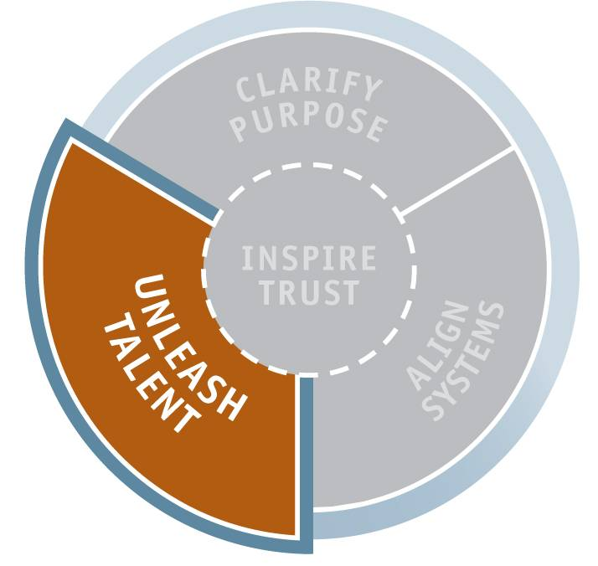
Imperative 4: Unleash Talent
Unleash Talent
100

Slide 3
Unleash Talent: Mind-Set
Mediocre Leader: I need to constantly motivate and manage my people to get results.
Great Leader: My job is to release the talent and passion of our team toward our highest priorities.
Unleash Talent
101

Slide 4
Unleash Talent: Skill-Set, Tool-Set, and Deliverables
Skill-Set
  Three leadership conversations:
    Voice
    Performance
    Clear the Path
Tool-Set
  “Voice” Conversation Planner
  Win-Win Performance Agreement
  “Performance” Conversation Planner
  “Clear the Path” Conversation Planner
Deliverables
  Contribution statement
  Draft of Win-Win Performance Agreement
Unleash Talent
101

Slide 5
The Power of Conversation
“Leadership is communicating to people their
worth and potential so clearly that they come
to see it in themselves.”
—Stephen R. Covey
Unleash Talent
99

Slide 6
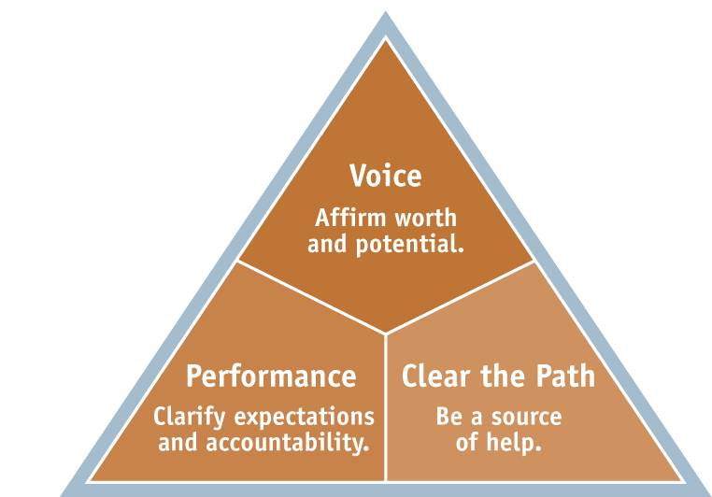
Three Leadership Conversations
Unleash Talent
102
Notes:
A leader’s ability to form a complementary, winning team happens as the leader gets to know individuals and engages their full potential towards the goals of the team.
This happens in three leadership conversations.

Slide 7
Leadership Conversation Reminders
  Every time you open your mouth, you create culture.
  These are the 80/20 conversations.
  They can be formal or informal, short or long.
  You are having them already, whether consciously or not.
  Look constantly for opportunities to turn a normal conversation into a leadership conversation.
Unleash Talent
103

Slide 8
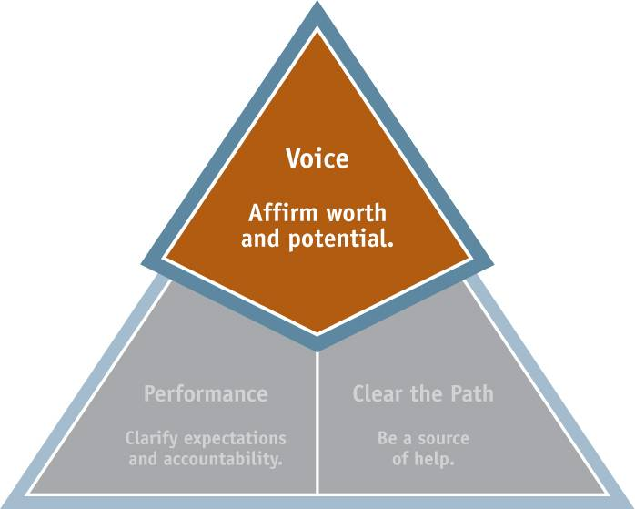
Conversation 1: Voice
Unleash Talent
104

Slide 9
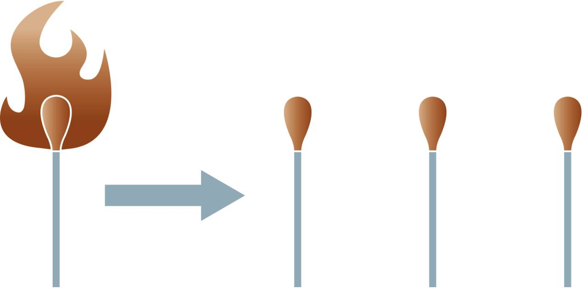
Light the Fire
To ignite the talent and passion of others, you must be fully engaged yourself.
Unleash Talent
105
Notes:
Have model changed. Has incorrect text under conscience. Need-what needs to be done, talent-what do I do best, conscience-what should I do, passion-what do I care about, voice-your distinctive contribution

Slide 10
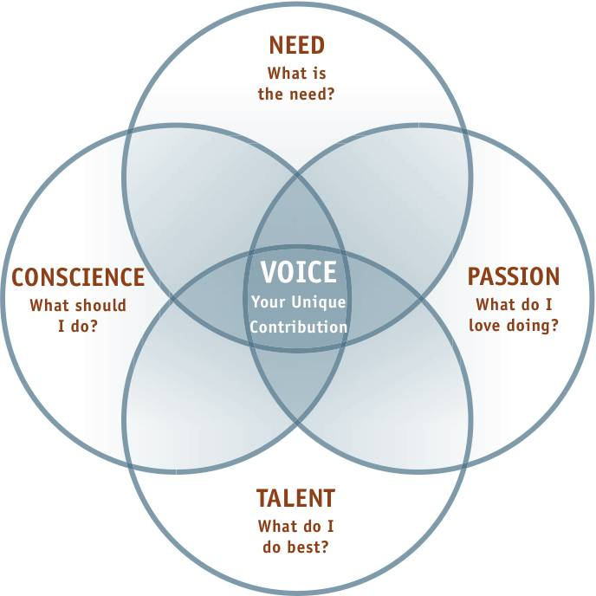
Finding Your Voice
Unleash Talent
106
Notes:
Have model changed. Has incorrect text under conscience. Need-what needs to be done, talent-what do I do best, conscience-what should I do, passion-what do I care about, voice-your distinctive contribution

Slide 11
The Tangible Output:
A Contribution Statement
Contribution
Statement
Unleash Talent
Notes:
The point is to find peoples unique talents and distill that into their highest contribution that they are passionate to give.
The tools to do this are just like the tools you used for yourself earlier.

Slide 12
Contribution Statement
A contribution statement describes the significant contribution you want to make in your current role at work.
Unleash Talent
111

Slide 13
Contribution Statement Example
Branch Manager, Men’s Clothing Store
As our Des Moines branch focuses on
returning customer service to its former
levels of excellence, I will personally
commit not only to treat each customer
as royalty, but also to treat each team
member with the same attitude in order
to grow an ethic of customer service in
our store.
Unleash Talent
112

Slide 14
Contribution Statement Example
Philip Yeo, Chairman of Singapore’s Economic Development Board
To provide our youth and future generations with meaningful jobs, a high standard of living, and a quality of life second to none.
Unleash Talent
112

Slide 15
Contribution Statement Example
Benjamin Zander, Conductor, Boston Philharmonic Orchestra
To share the most powerful language ever devised by human beings…that stirs one’s soul, rearranges one’s molecules, turns one’s being inside out. It gives you a new insight on life, a new place to stand, a new range of experiences.
Unleash Talent
112

Slide 16
Your Contribution Statement
As you consider your team’s purpose and vision, what unique contribution do you want to make in your current leadership role?
Unleash Talent
111

Slide 17
The Value of a Contribution
Statement
“Whenever anyone goes to his or her associates
and says, ‘This is the contribution I plan to concentrate on and the results I should be expected to deliver,’ the response is always, ‘Why didn’t you tell me earlier?’”
—Peter Drucker
Unleash Talent

Slide 18
Communicate Your Contribution
  Stand up at your table.
  Take 2 minutes to share the contribution you plan to make as a leader to achieve the purpose and vision of your team.
Unleash Talent

Slide 19
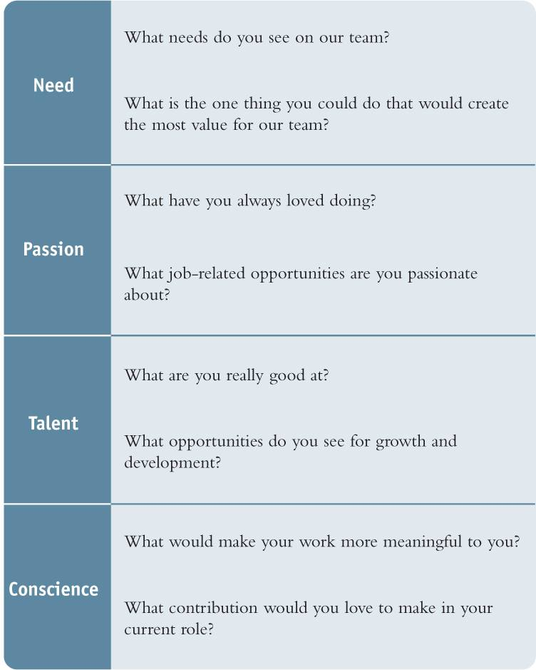
Voice Finder Questions
Unleash Talent
114
Notes:
Create Graphic from pg 112.

Slide 20
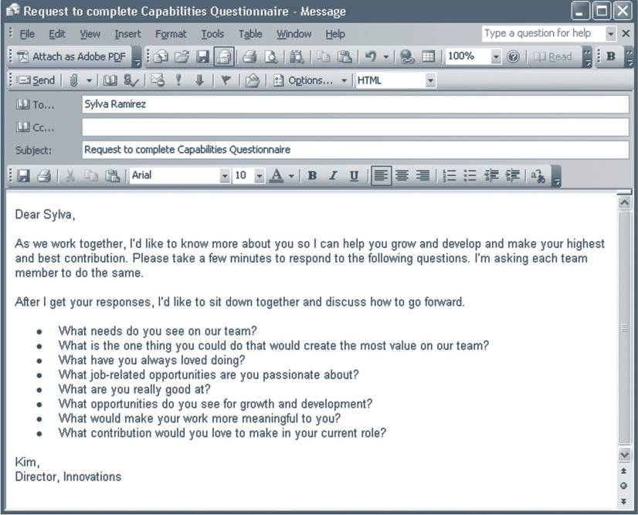
Voice Finder E-Mail
Unleash Talent
115
Notes:
Not the right place buddha!

Slide 21
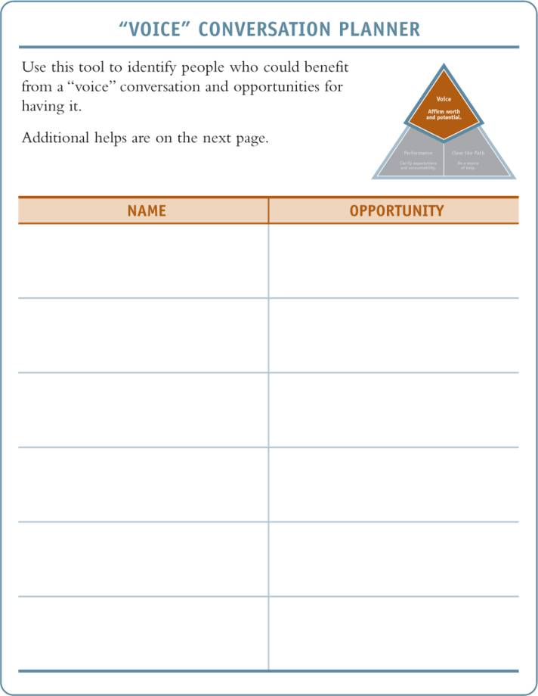
“Voice” Conversation Planner
Unleash Talent
116
Notes:
Create Graphic from pg 114.

Slide 22
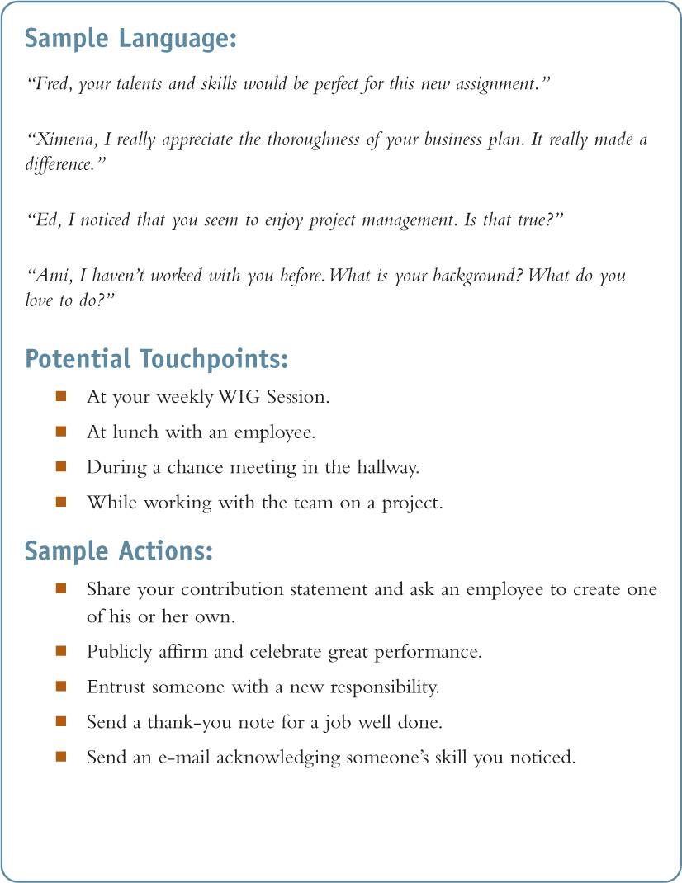
“Voice” Conversation Planner
Unleash Talent
117
Notes:
Create Graphic from pg 114.

Slide 23
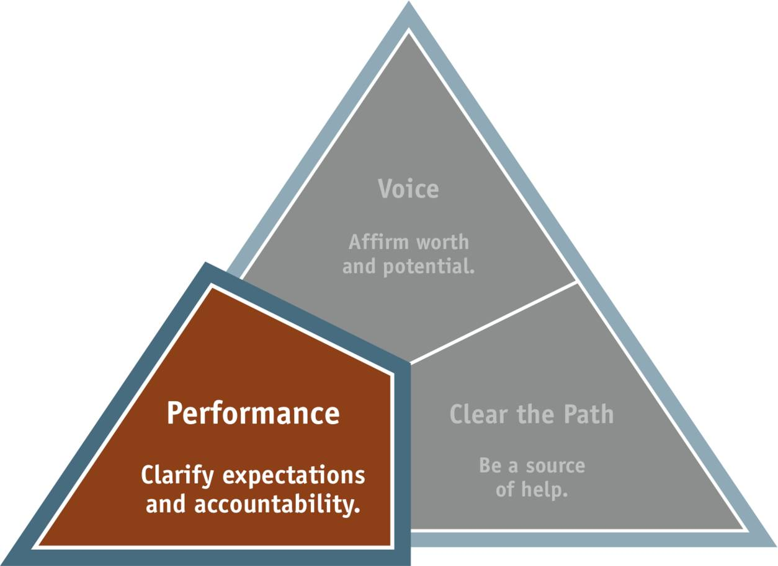
Conversation 2: Performance
Unleash Talent
118

Slide 24
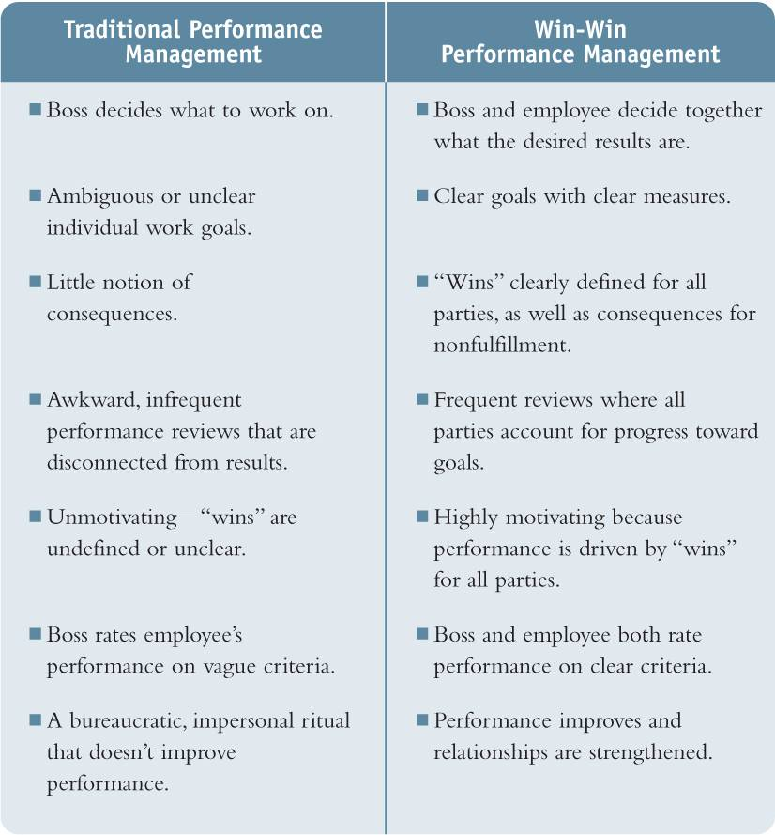
A New Paradigm for
Performance Management
Unleash Talent
119

Slide 25
Levels of Initiative
Negotiate the right level of initiative with each person based on:
  The perceived risk (visibility, cost, importance, etc.).
  The person’s character (trustworthiness, follow-through, etc.).
  The person’s competence (knowledge, skills, experience, etc.).
Unleash Talent
120

Slide 26
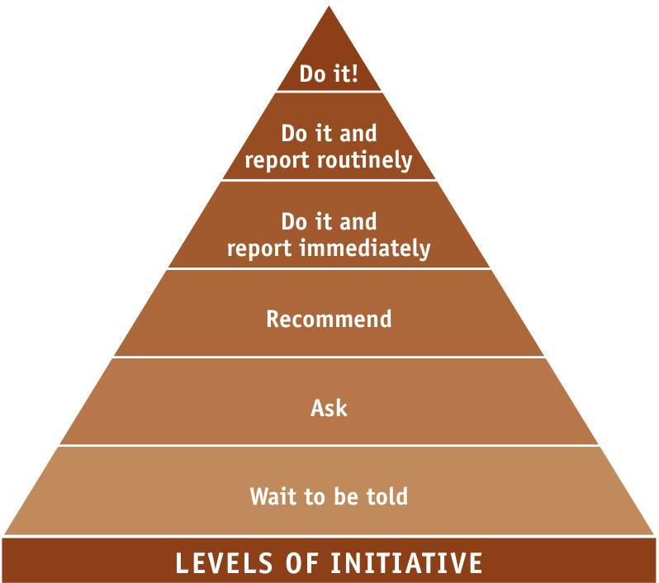
Levels of Initiative
Unleash Talent
120

Slide 27
Win-Win Performance
Agreement
  Desired Results. The few key goals to focus on.
  Guidelines. The standards and conditions that must be met.
  Resources. The resources required to complete the agreement.
  Accountability. The way you will account to each other.
  Consequences. The results of fulfilling or not fulfilling the agreement.
Unleash Talent
121

Slide 28
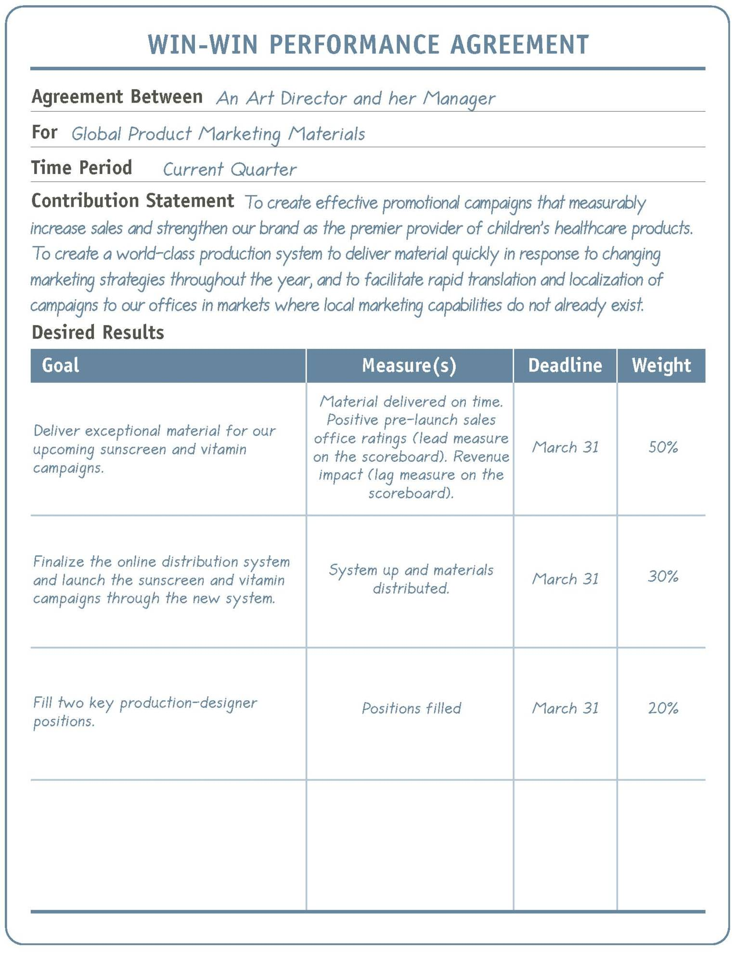
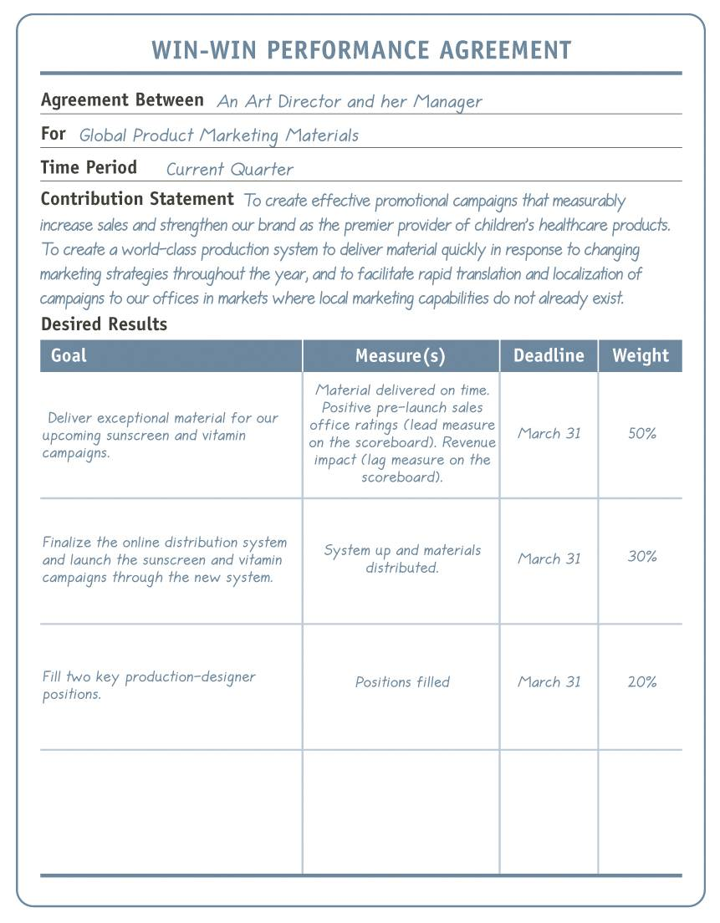
Win-Win Performance
Agreement Example
Unleash Talent
122

Slide 29
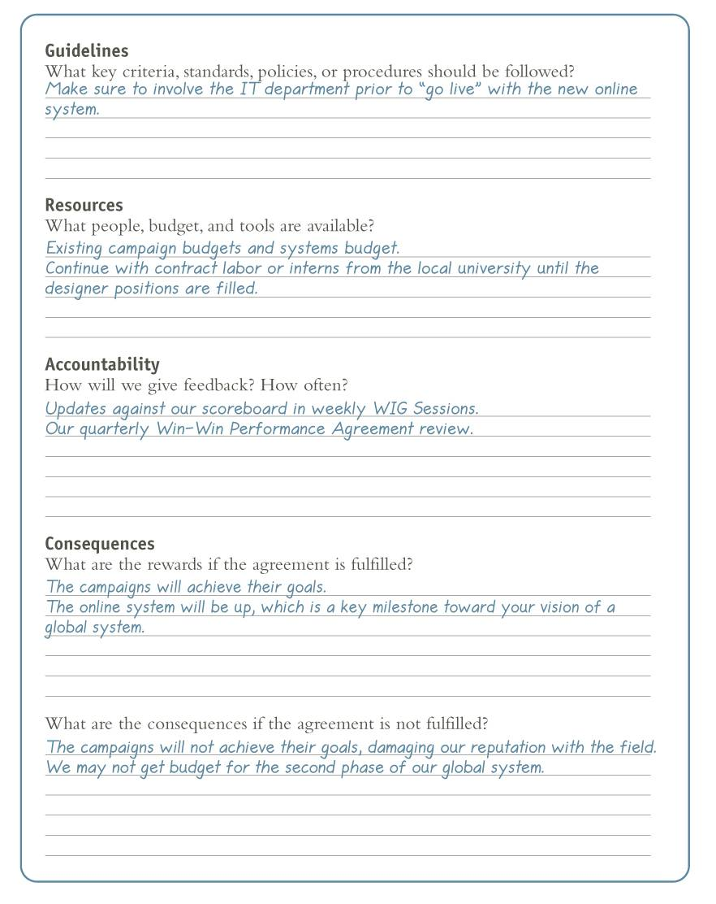
Win-Win Performance
Agreement Example
Unleash Talent
123

Slide 30
Win-Win Performance
Agreement
Create a draft of a Win-Win Performance Agreement between you and your boss.
Unleash Talent

Slide 31
Win-Win Performance
Agreement Process
  Send an e-mail asking employees to answer the “Voice Finder” questions.
  Meet with the employee to discuss the Voice Finder questions and his or her contribution.
  Ask the employee to write a first draft of the Win-Win Performance Agreement.
  Meet with the employee to review and revise the agreement.
Unleash Talent
124

Slide 32
What Do I Watch Out For?
  Don’t just “hand down” the Win-Win Performance Agreement to the team member.
  Don’t just “hand it up” either; define it together.
  Clearly define the win. It should be more than just “you get to keep your job.”
  Don’t shelve it.
  Limit the key results to the few goals you must achieve.
  Make sure the goals and measures are clear.
Unleash Talent
125

Slide 33
What Do I Watch Out For?
  Adapt the tool to work for you and each team member.
  Don’t allow the team member to turn the win-win conversation to his or her benefit by discussing all of his or her wins instead of thinking about wins for the organization.
  Don’t shy away from raising difficult issues, such as how the person feels about his or her job.
  If you already have an existing performance system and can’t replace it, use Win-Win Performance Agreements in addition.
Unleash Talent
125

Slide 34
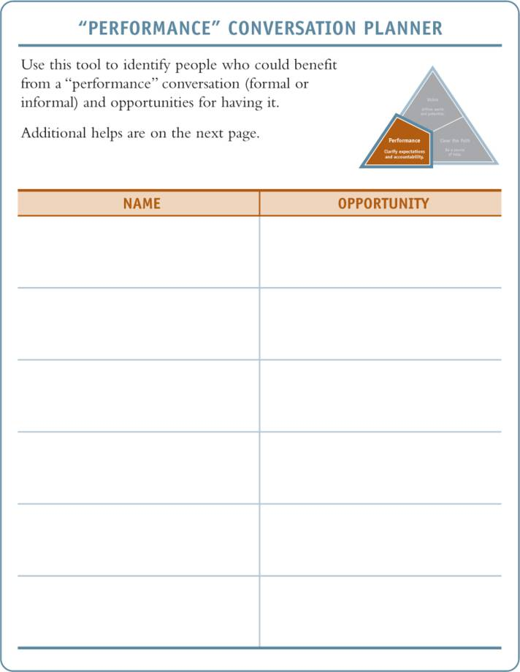
“Performance” Conversation Planner
Unleash Talent
126

Slide 35
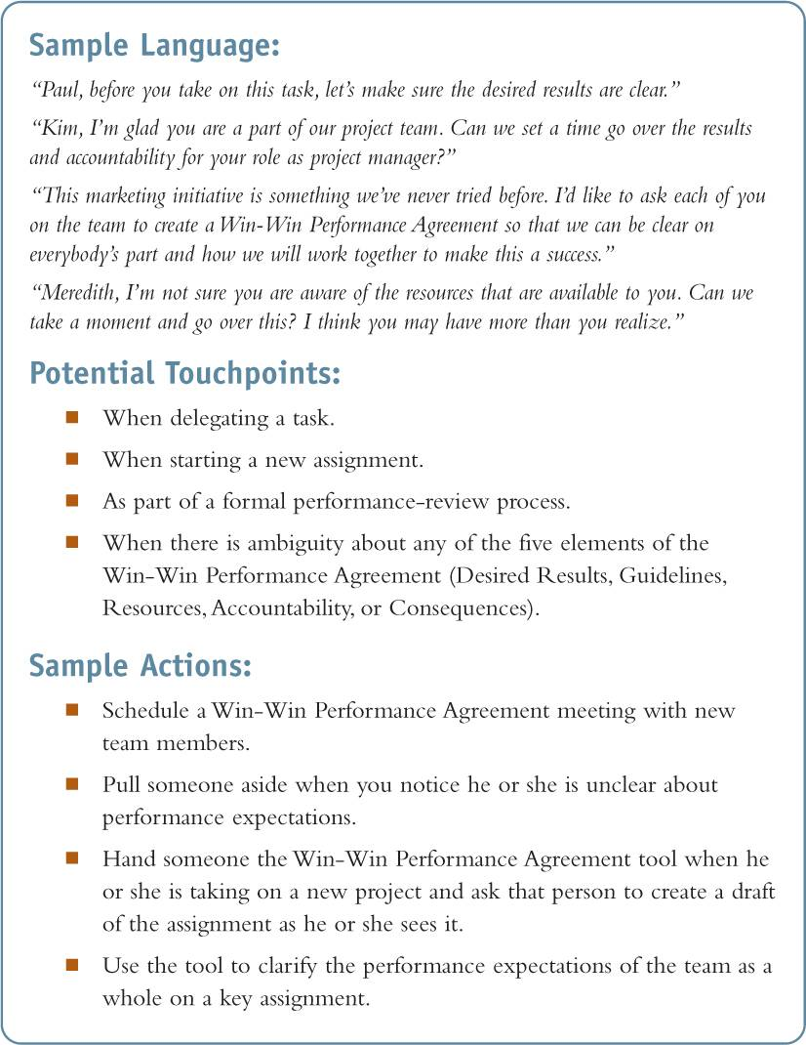
“Performance” Conversation Planner
Unleash Talent
127

Slide 36
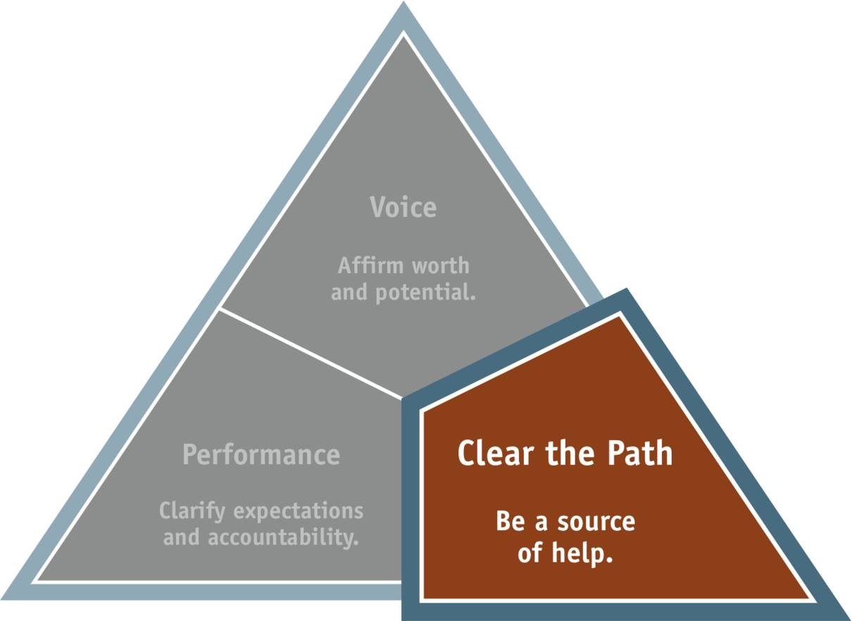
Conversation 3: Clear the Path
Unleash Talent
128

Slide 37
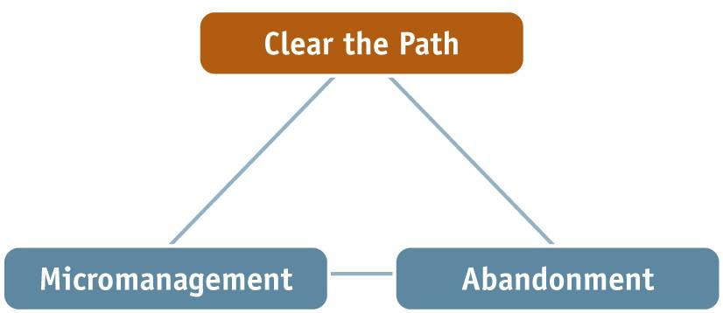
“Clear the Path”—A Third Alternative
Micromanagement: A manager who constantly hovers over and checks
up, never giving full control or ownership to another person.
Abandonment: A manager who gives people responsibility without support.
Clear the Path: A leader who neither micromanages nor abandons,
but “runs alongside” and supports people as they achieve mutually
agreed-upon goals.
Unleash Talent
129
Notes:
Create graphic from page 127

Slide 38
What Do I Watch Out For?
  Don’t allow people to shift responsibility to you.
  If you see someone failing, resist the temptation to jump in and take over.
  If there is a failure, help the individuals involved learn from their experience.
  Don’t be afraid to let people stretch.
Unleash Talent
130

Slide 39
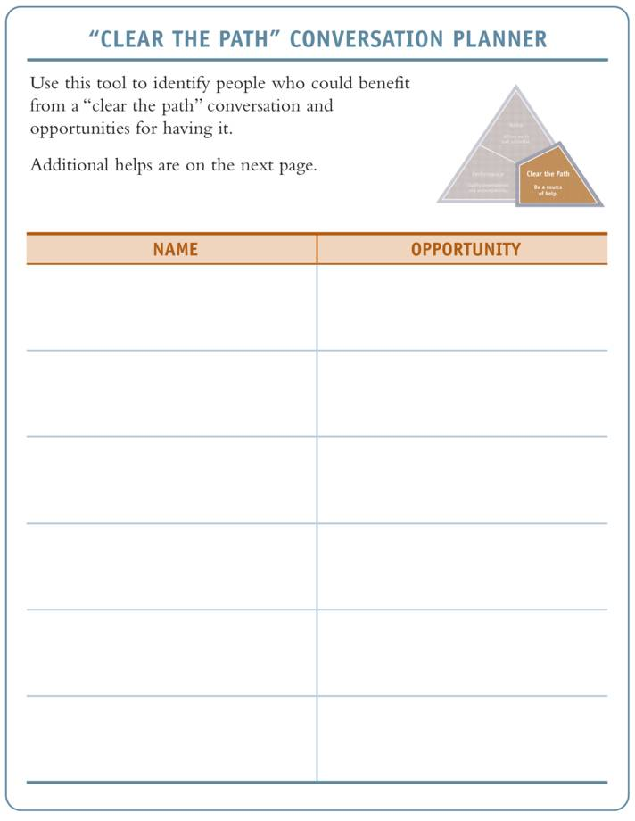
“Clear the Path” Conversation Planner
Unleash Talent
131

Slide 40
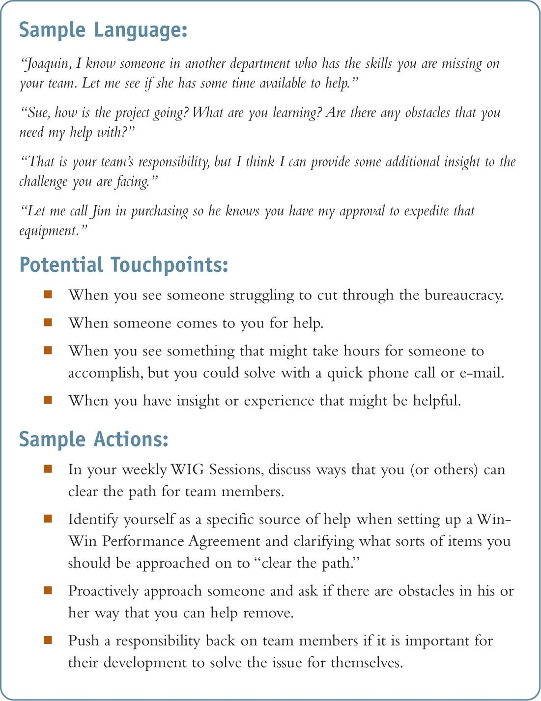
“Clear the Path” Conversation Planner
Unleash Talent
132
Notes:
Put graphic of tool from page 129.

